Slide 1
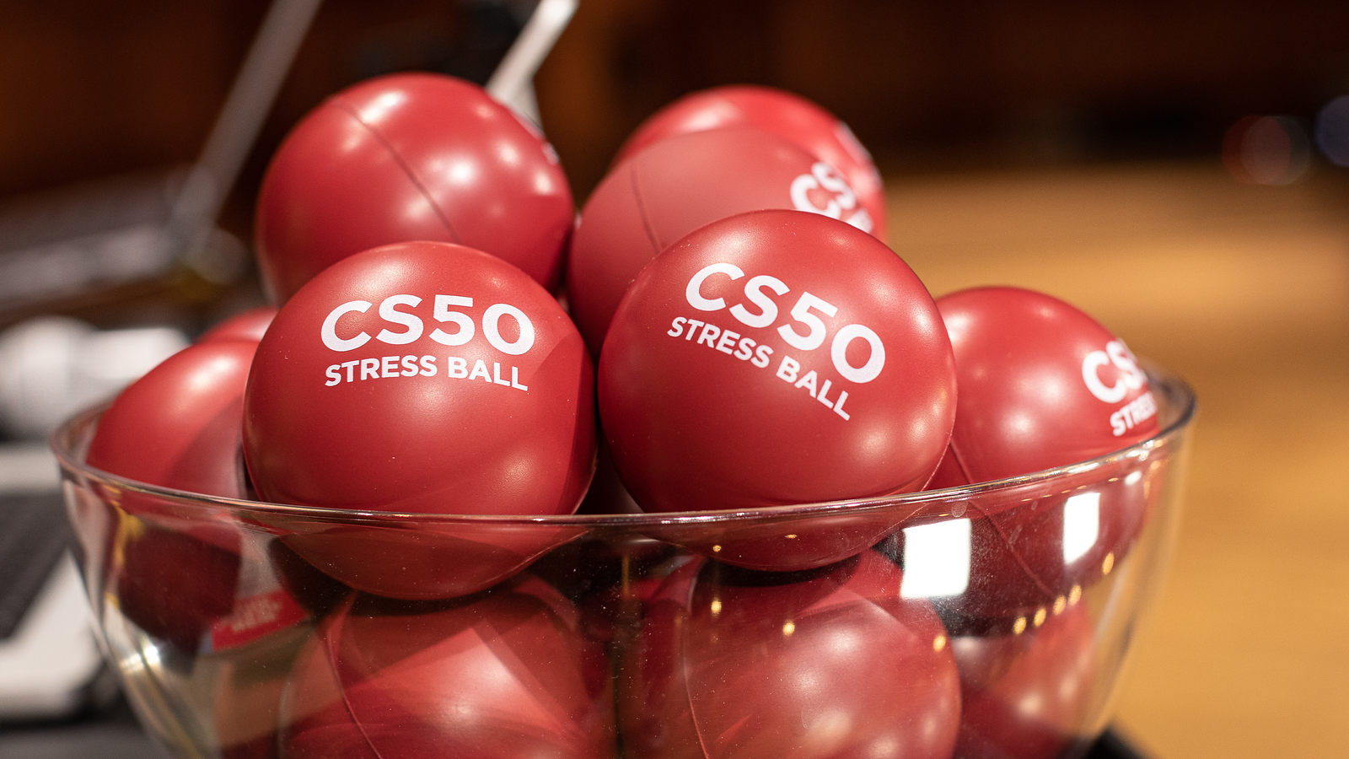

Slide 2
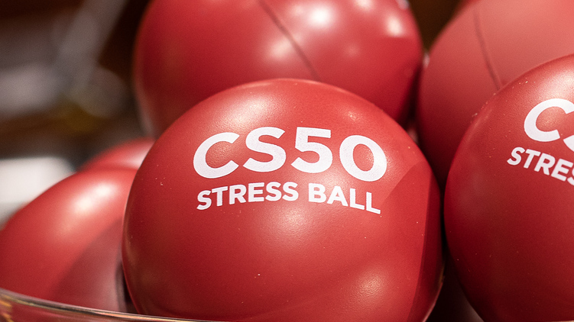

Slide 3
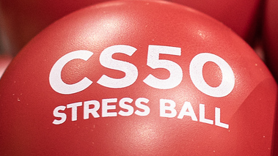

Slide 4


Slide 5


Slide 6


Slide 7
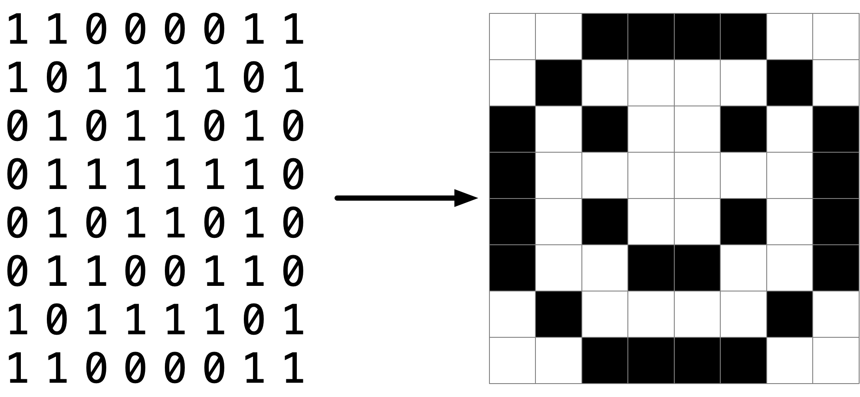

Slide 10
pixel art

Slide 11
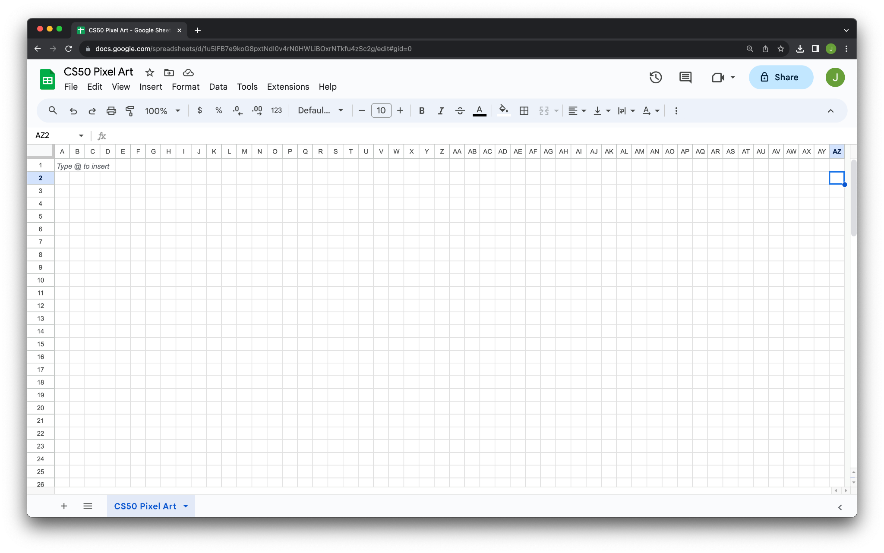

Slide 12
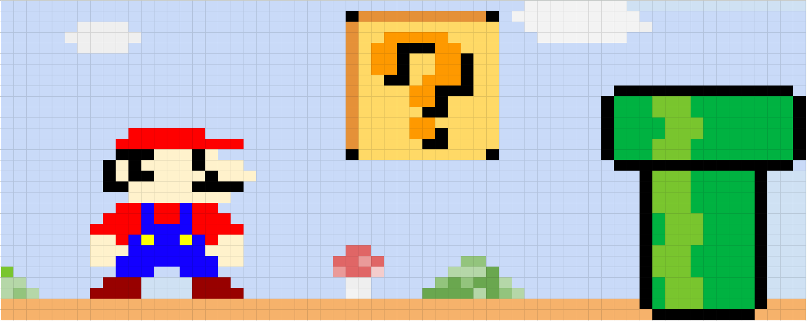

Slide 13
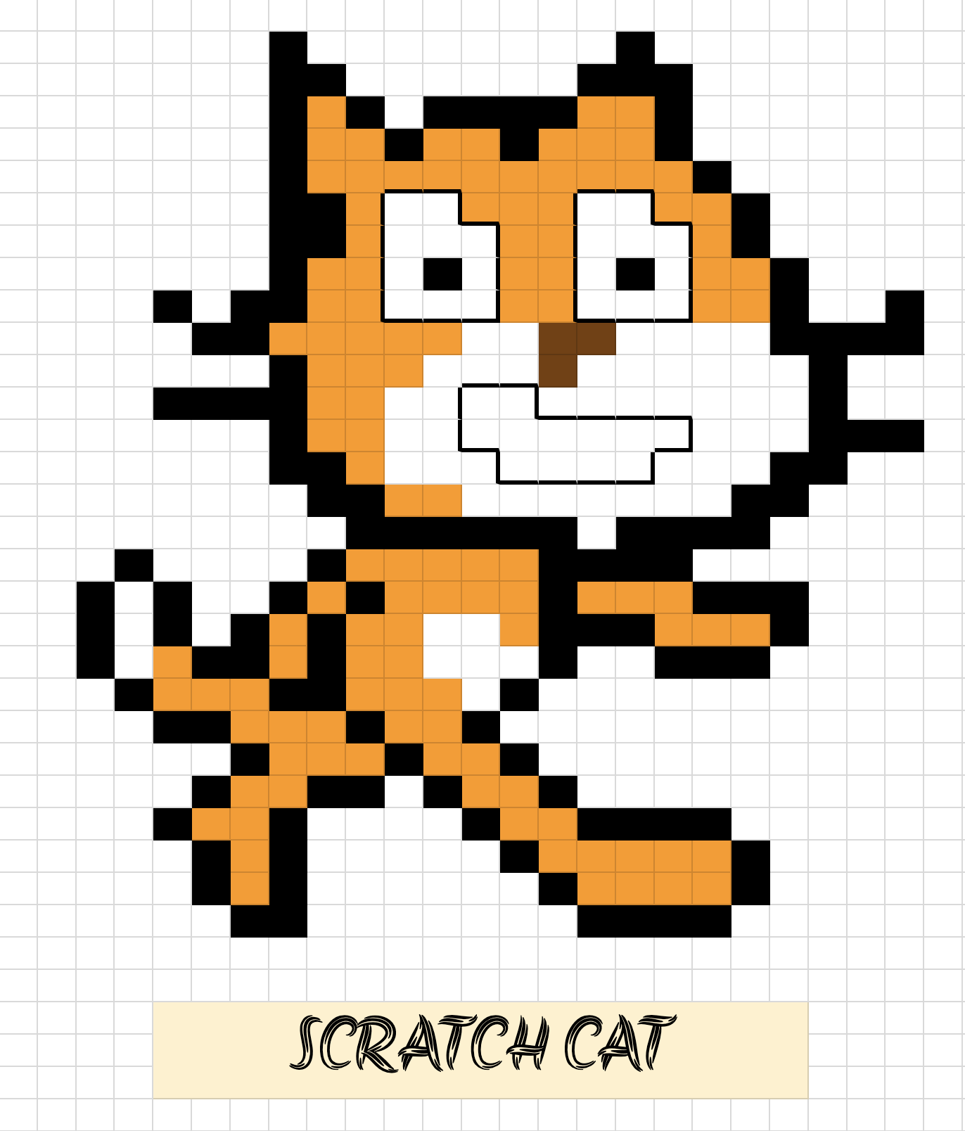

Slide 14
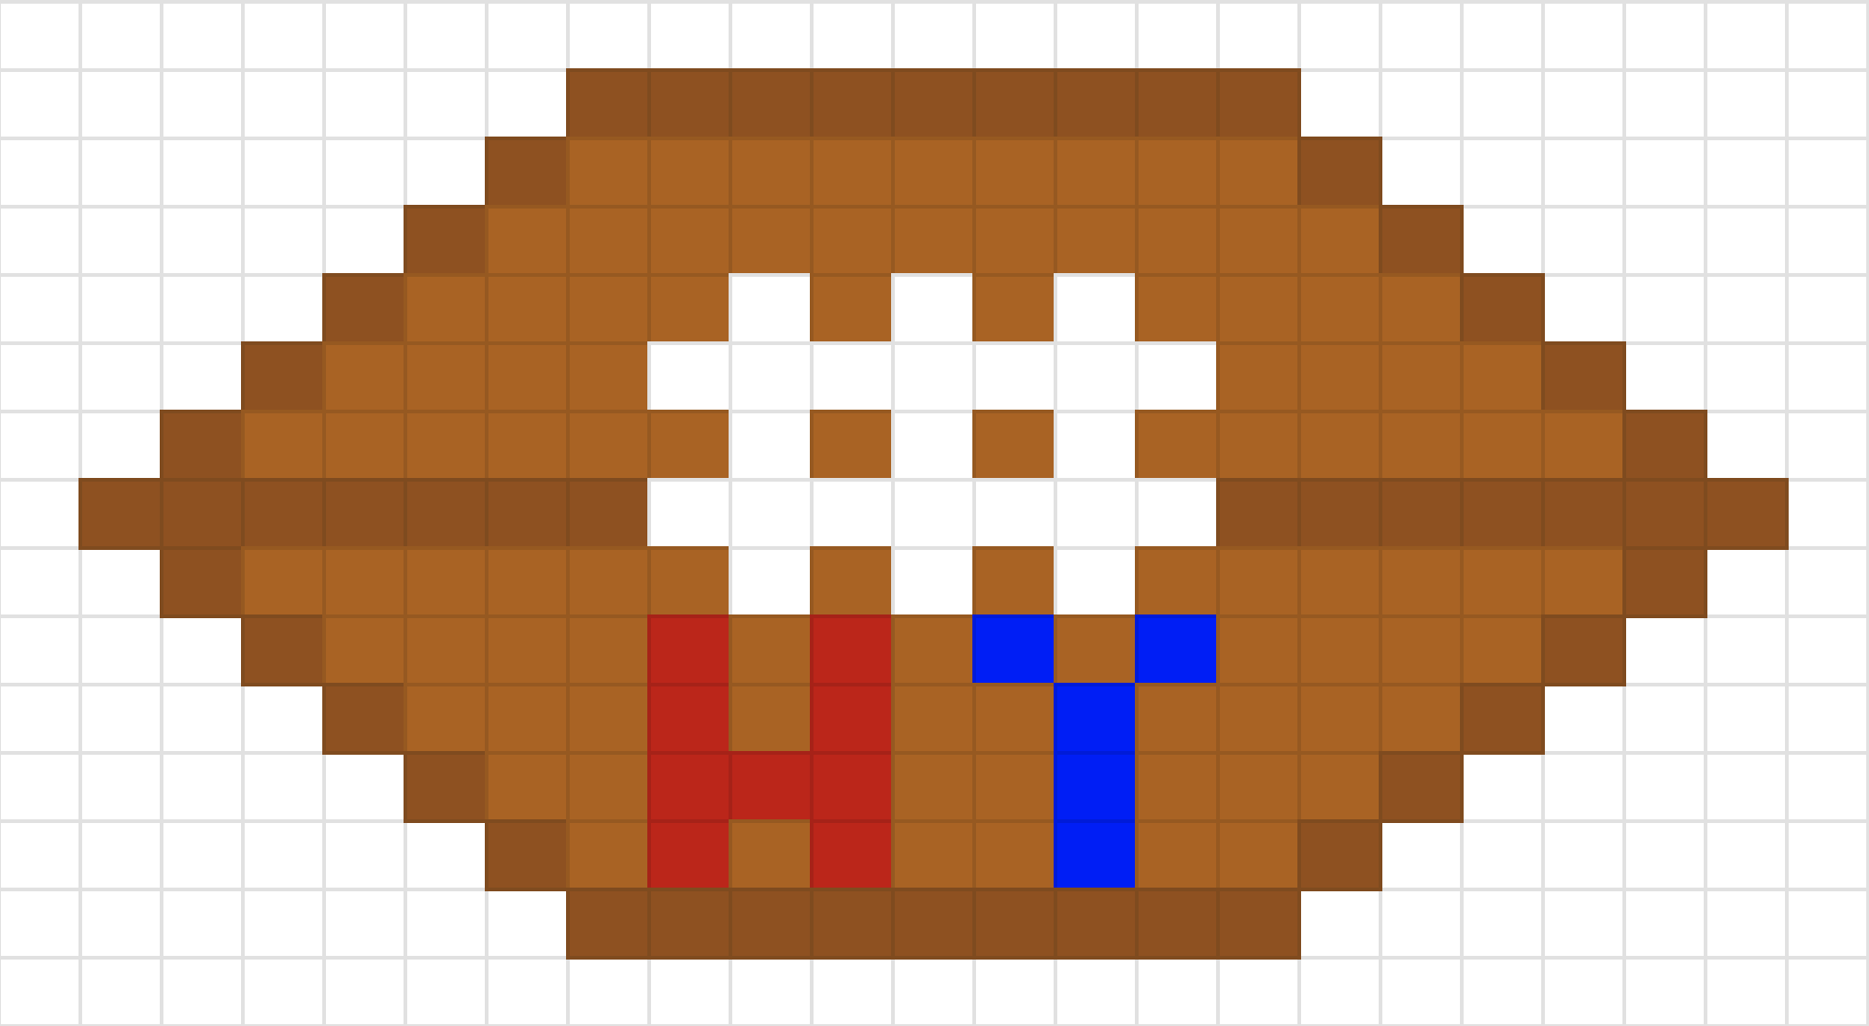

Slide 15


Slide 16
cs50.ly/art

Slide 17
RGB

Slide 18
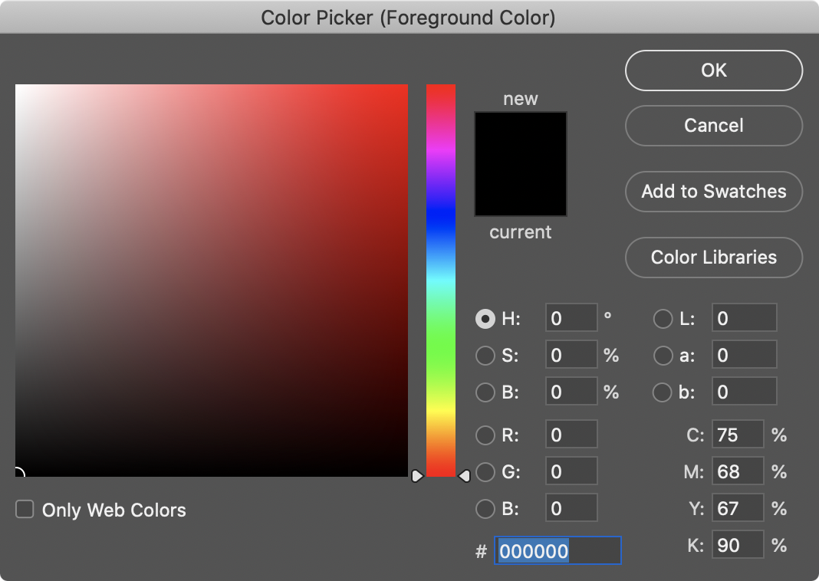

Slide 19
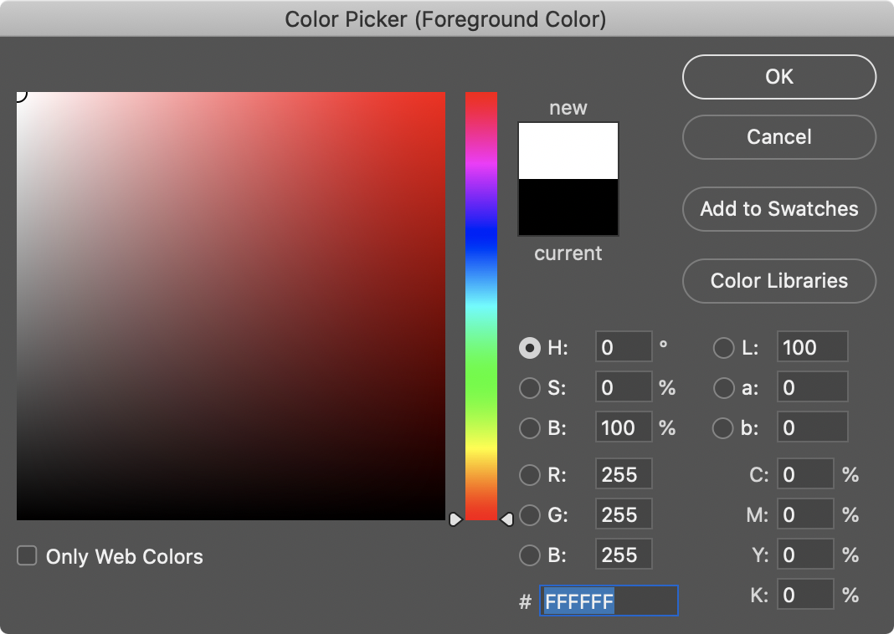

Slide 20
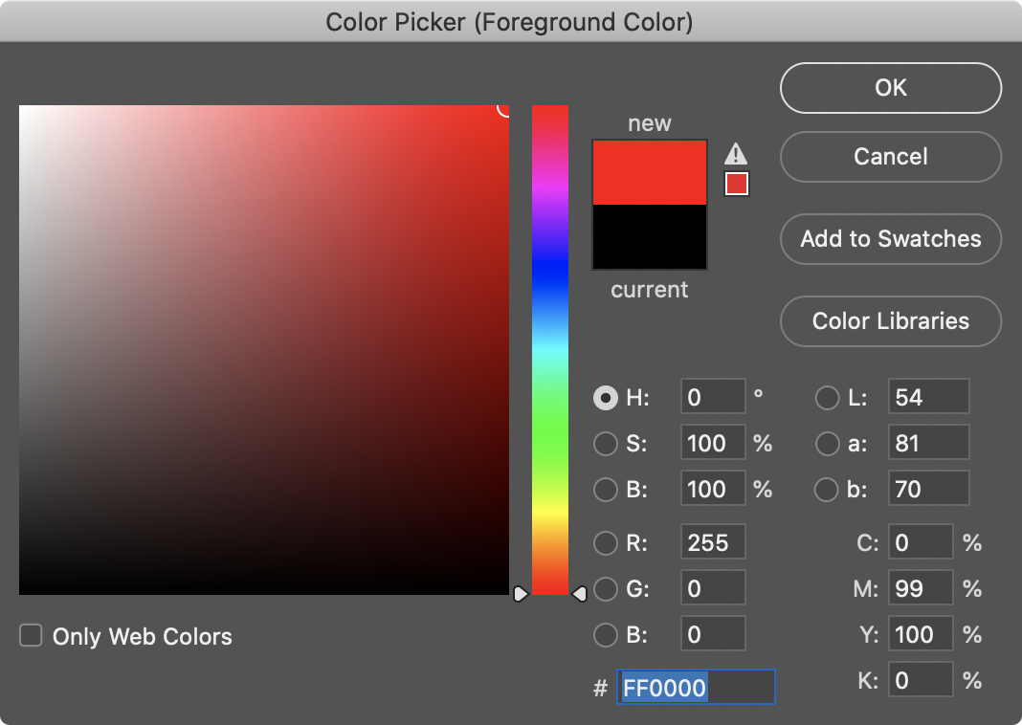

Slide 21
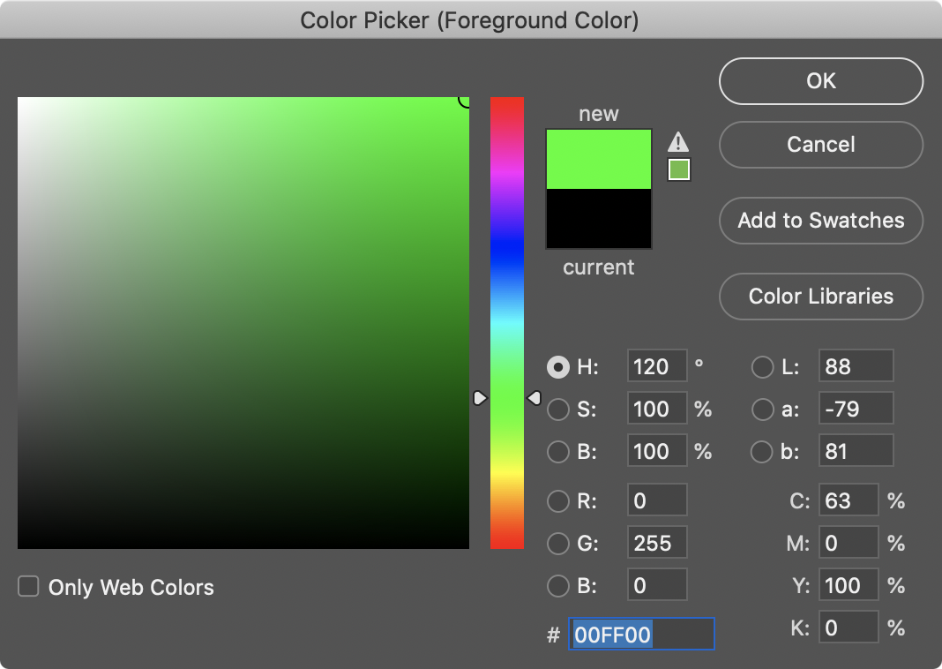

Slide 22
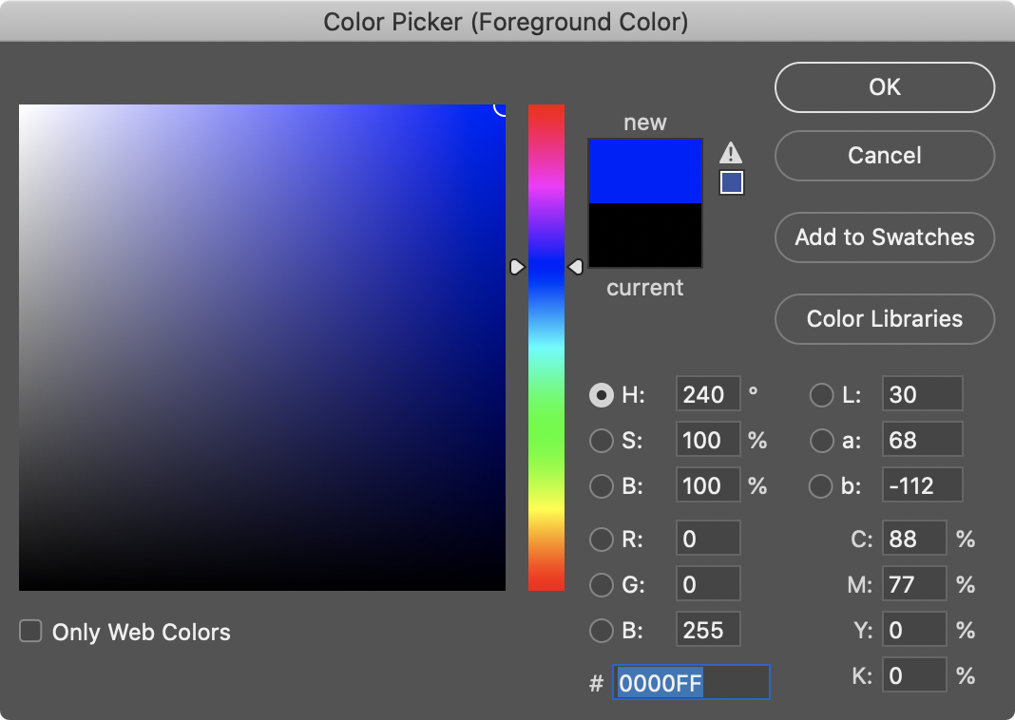

Slide 23
1 0 2 3 4 5 6 7 8 9 A B C D E F

Slide 24
0 1 2 3 4 5 6 7 8 9 A B C D E F

Slide 25
0 1 2 3 4 5 6 7 8 9 A B C D E F

Slide 26
0 1 2 3 4 5 6 7 8 9 a b c d e f

Slide 27
hexadecimal

Slide 28
base-16

Slide 29
16¹
16⁰
# #

Slide 30
16
1
# #

Slide 31
16
1
00

Slide 32
16
1
01

Slide 33
16
1
02

Slide 34
16
1
03

Slide 35
16
1
04

Slide 36
16
1
05

Slide 37
16
1
06

Slide 38
16
1
07

Slide 39
16
1
08

Slide 40
16
1
09

Slide 41
16
1
0A

Slide 42
16
1
0B

Slide 43
16
1
0C

Slide 44
16
1
0D

Slide 45
16
1
0E

Slide 46
16
1
0F

Slide 47
16
1
10

Slide 48
16
1
11

Slide 49
16
1
12

Slide 50
16
1
13

Slide 51
16
1
14

Slide 52
16
1
…

Slide 53
16
1
FF

Slide 54
16
1
FF
16 × F
+
1 × F

Slide 55
16
1
FF
16 × 15
+
1 × 15

Slide 56
16
1
FF
240
+
15

Slide 57
16
1
FF
255

Slide 58
F

Slide 59
1111

Slide 60
11111111

Slide 61
FF

Slide 63
0 | 1 | 2 | 3 | 4 | 5 | 6 | 7
8 | 9 | 10 | 11 | 12 | 13 | 14 | 15
16 | 17 | 18 | 19 | 20 | 21 | 22 | 23
24 | 25 | 26 | 27 | 28 | 29 | 30 | 31

Slide 64
0 | 1 | 2 | 3 | 4 | 5 | 6 | 7
8 | 9 | A | B | C | D | E | F
10 | 11 | 12 | 13 | 14 | 15 | 16 | 17
18 | 19 | 1A | 1B | 1C | 1D | 1E | 1F

Slide 65
0 | 1 | 2 | 3 | 4 | 5 | 6 | 7
8 | 9 | A | B | C | D | E | F
10 | 11 | 12 | 13 | 14 | 15 | 16 | 17
18 | 19 | 1A | 1B | 1C | 1D | 1E | 1F

Slide 66
0x0 | 0x1 | 0x2 | 0x3 | 0x4 | 0x5 | 0x6 | 0x7
0x8 | 0x9 | 0xA | 0xB | 0xC | 0xD | 0xE | 0xF
0x10 | 0x11 | 0x12 | 0x13 | 0x14 | 0x15 | 0x16 | 0x17
0x18 | 0x19 | 0x1A | 0x1B | 0x1C | 0x1D | 0x1E | 0x1F

Slide 67
int n = 50;

Slide 69
 |  |  |  | 50 n

Slide 70
 |  |  |  | 50 0x123

Slide 71
&
*

Slide 72
pointers

Slide 73
int n = 50;
int *p = &n;

Slide 74
int n = 50;
int *p = &n;

Slide 75
int n = 50;
int* p = &n;

Slide 76
int n = 50;
int * p = &n;

Slide 77
int n = 50;
int *p = &n;

Slide 79
 |  |  |  | 50 n

Slide 80
 |  |  |  | 50 0x123

Slide 81
0x123 p
 |  |  |  | 50 0x123

Slide 82
0x123 p
 |  |  |  | 50 0x123

Slide 83
p
 |  |  |  | 50 0x123

